Slide 1
FLOW CHART
STUDENT GRADES RECORD

Slide 2
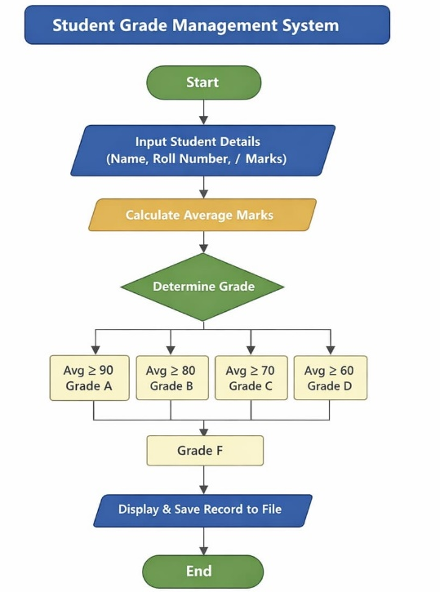
FLOWCHART

